Slide 1
MNIST Recognition by Neural Network - Siva Keerthi Putluri

Slide 2
Introduction
I implemented a Convolutional Neural Network, or CNN, to recognize handwritten digits using the MNIST dataset.
The MNIST dataset contains 60,000 training images and 10,000 testing images of handwritten digits from 0 to 9.

Slide 3
Model
Chose a CNN because convolutional neural networks are very effective for image classification tasks.
The model consists of convolution layers that extract image features, followed by fully connected layers that perform the final classification.
During training, the network learns patterns such as edges, shapes, and digit structures.

Slide 4
Training and Results
The model was trained on the training dataset and evaluated on the test dataset.
After training, the CNN achieved high recognition accuracy on unseen test images.
The results demonstrate that neural networks can effectively learn visual patterns from handwritten digits.

Slide 5
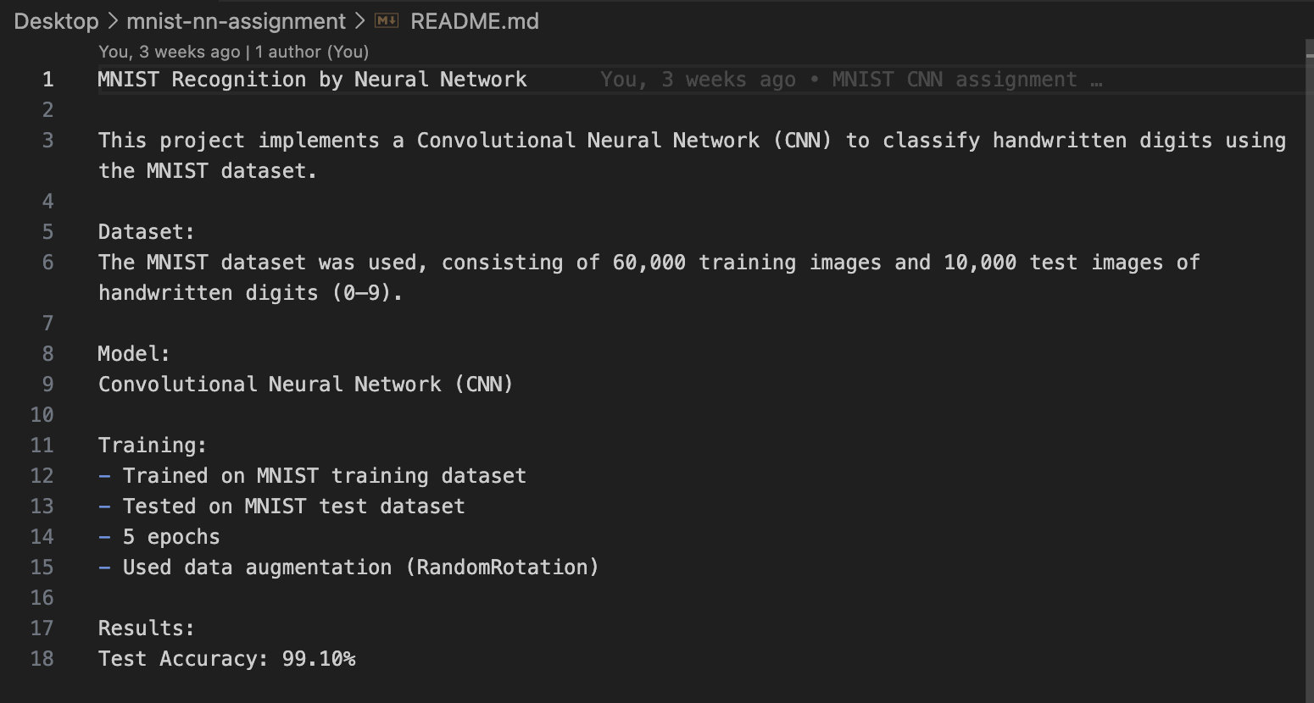

Slide 6
Takeaway
My main takeaway from this assignment is that CNNs are powerful image recognition models because they automatically learn useful features from raw images without manual feature engineering.

Slide 7
Thank you

